Slide 1

Machine Learning applications in Healthcare Sector
SRM INSTITUTE OF SCIENCE AND TECHNOLOGY
SCHOOL OF COMPUTING
DEPARTMENT OF COMPUTER SCIENCE AND ENGINEERING
18CSP107L / 18CSP108L - MINOR PROJECT / INTERNSHIP
Batch ID:4H_MP03030015
Student 1 Reg. No:RA2011003030005
Student 1 Name: Aman Kumar
Student 2 Reg. No: RA2011003030012
Student 2 Name: Kartikey Teotia
Student 3 Reg. No:RA2011003030015
Student 3 Name:Manas Kumar
Student 4 Reg. No:RA2011003030032
Student 4 Name:Akul Goel
Guide name: Mr.Mayank Gupta
Designation: Assistant Professor Department: Computer Science

Slide 2
Machine Learning applications in Healthcare Sector
Abstract
This project report presents the design and development of Machine learning applications in healthcare sector. The system aims to improve healthcare access and quality by providing patients with personalized diagnosis for their problems. The report discusses the challenges of traditional healthcare systems and how the machine learning addresses these issues.Overall, our healthcare application of machine learning system has the potential to improve healthcare access and quality.

Slide 3
Machine Learning applications in healthcare sector
Introduction
Machine Learning is reshaping the landscape of healthcare, introducing innovative approaches to diagnosis and treatment. In this project, we deliver into the application of Machine Learning specifically in predicting Health diseases, a critical area in global health. Through the analysis of key medical attributes, we aim to create a robust predictive model that can assist in early detection and intervention, potentially saving countless lives.

Slide 4
Machine Learning applications in
healthcare sector
Scope of the Project
Comprehensive Data Collection: Gather data from diverse sources to ensure a holistic understanding of the myriad factors influencing heart disease. This includes demographic information, lifestyle choices, and clinical indicators.
Machine Learning Techniques: Implement machine learning techniques to process and analyze the collected data. The choice of algorithms is crucial, and we explore multiple models to determine the most accurate and reliable predictor.
Graphical User Interface: Develop a Tkinter-based GUI that not only serves as a conduit for user input but also as a visual aid in conveying the predictions generated by the machine learning model. The GUI is designed to be user-friendly and informative.

Slide 5
Machine Learning applications in healthcare sector
Problem statement and Objectives
The problem we aim to address is the difficulty in accurately diagnosing health conditions based on online datasets. Traditional diagnostic methods rely on a combination of symptom observation, physical examination, and laboratory testing. However, these methods can be time-consuming, expensive, and may not always lead to a definitive diagnosis.
The goals of the proposed system are as follows:
Increase the accuracy of health diagnosis
Provide timely healthcare recommendations
Improve patient outcomes
Reduce healthcare costs
Improve patient satisfaction
Facilitate research

Slide 6
Machine Learning applications in healthcare sector
Proposed System
There are various ways to develop such a system, but the most promising methods include data pre-processing, feature selection, classification algorithms, and model evaluation.
Data Pre-processing: The first step in developing a machine learning health improvement system.
Feature Selection: the process of identifying the most relevant features or variables that are predictive of the target outcome.
Classification Algorithms: Used to predict the target outcome based on the input features.
Model Evaluation: The process of assessing the performance of the machine learning models

Slide 7
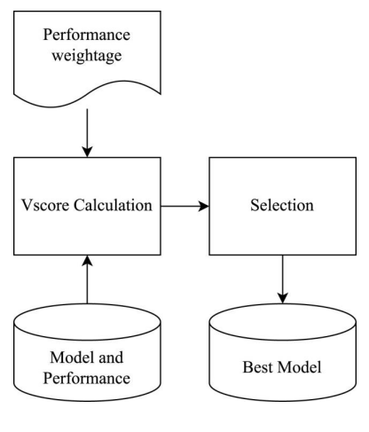
Machine Learning applications in healthcare sector
Block Diagram of the proposed model
Block Diagram

Slide 8
Machine Learning applications in healthcare sector
Modules Description
Data Collection and Pre Processing
Literature Review
Model Selection and Development
Real-time Data Processing
User Interface and Integration
Ethical Considerations and Compliance
Testing and Validation
Results and Insights
Documentation and Deployment
Future Enhancements and Maintenance

Slide 9
Machine Learning applications in healthcare sector
Intermediate Results and Discussion
In our machine learning project within the healthcare sector focused on heart health, we have made significant progress in data collection and preprocessing. We have gathered a comprehensive dataset comprising various patient parameters, medical histories, and diagnostic records. Initial preprocessing steps involved data cleaning to handle missing values and outliers, as well as feature engineering to extract relevant information. Our discussions have centered on feature selection techniques and ensuring data privacy and security. The intermediate results show promising potential for predictive modeling, with a focus on improving model accuracy while maintaining interpretability to assist healthcare professionals in early heart disease detection.

Slide 10
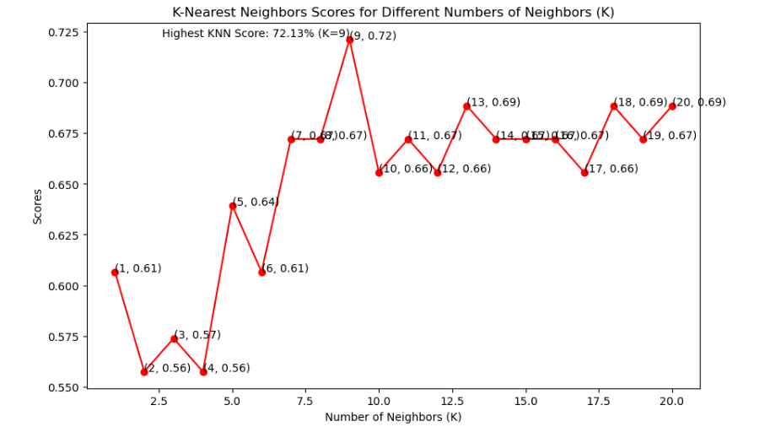
Machine Learning applications in healthcare sector
K Neighbors Classifier
This classifier looks for the classes of K nearest neighbors of a given data point and based on the majority class, it assigns a class to this data point.
As you can see, we achieved the maximum score of 72.13%

Slide 11
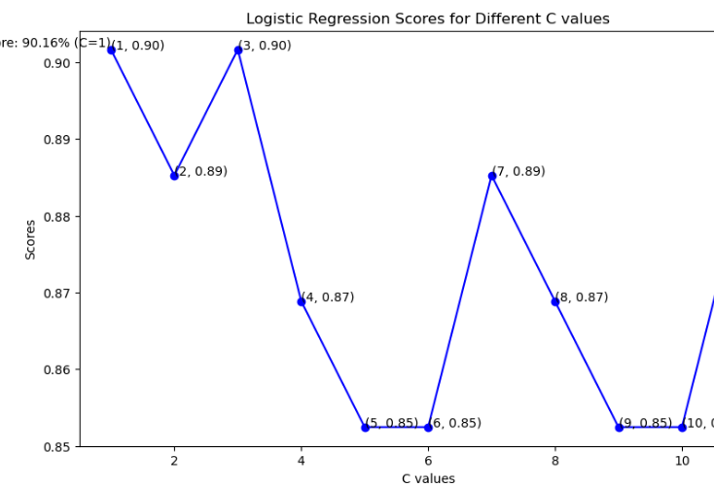
Machine Learning applications in healthcare sector
Logistic Regression
Logistic regression predicts binary outcomes by combining input features linearly and applying the logistic (sigmoid) function to generate probabilities.
As can be seen from the plot above, the linear kernel performed the best for this dataset and achieved a score of 90.16%.

Slide 12
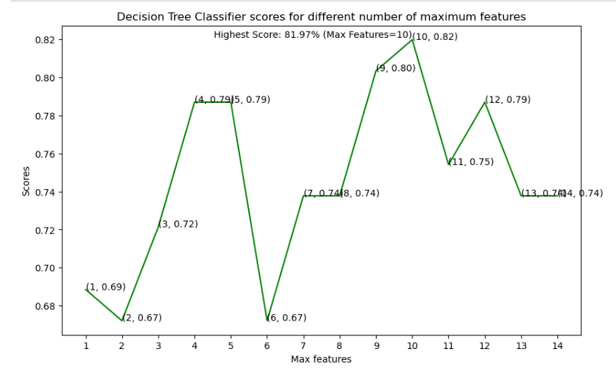
Machine Learning applications in healthcare sector
Decision Tree Classifier
This classifier creates a decision tree based on which, it assigns the class values to each data point.
From the line graph above, we can clearly see that the maximum score is 81.97% .

Slide 13
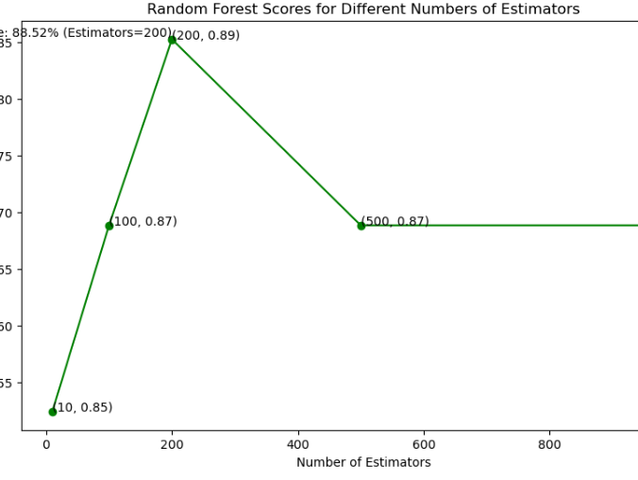
Machine Learning applications in healthcare sector
Random Forest Classifier
This classifier takes the concept of decision trees to the next level. It creates a forest of trees where each tree is formed by a random selection of features from the total features.
Taking a look at the graph graph, we can see that the maximum score of 88.52%.

Slide 14
Machine Learning applications in healthcare sector
Conclusion
The project involved analysis of the heart disease patient dataset with proper data processing. Then, 4 models were trained and tested with maximum scores as follows:
K Neighbors Classifier: 71.3%
Logistic Regression : 90.1%
Decision Tree Classifier: 79%
Random Forest Classifier: 81.97%

Slide 15
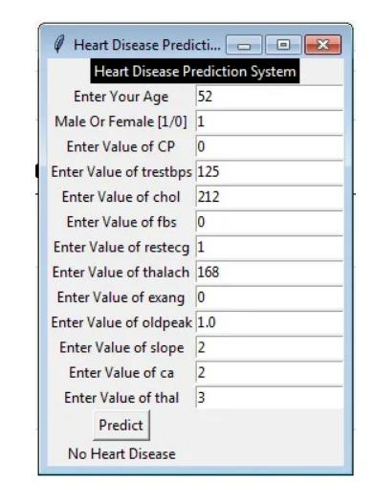
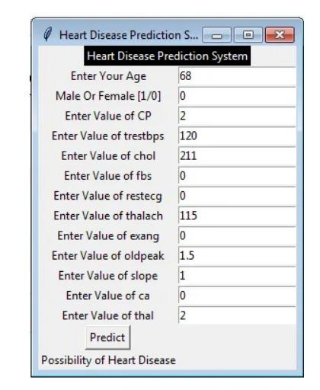
Machine Learning applications in healthcare sector
User Interface and Output

Slide 16
Machine Learning applications in healthcare sector
References
Chaitrali S. Dangare “Improved Study Of Heart Disease Prediction System Using Data Mining Classification Techniques”. Published In International Journal of Computer Applications 2017
T.Nagamani, S.Logeswari, B.Gomathy Heart Disease Prediction Using Data Mining With Mapreduce Algorithm Published In International Journal Of Innovative Technology And Exploring Engineering (Ijitee) 2019
H. Benjamin Fredrick David And S. Antony Belcy Heart Disease Prediction Using Data Mining Techniques Published In Ictact Journal On Soft Computing 2018 https://www.heartfoundation.org/statistics, 2018.
Senthilkumar Mohan ; Chandrasegar Thirumalai ; Gautam Srivastava Effective Heart Disease Prediction Using Hybrid Machine Learning Techniques Publisher: IEEE
Polonsky TS, McClelland RL, Jorgensen NW, et al. Coronary Artery Calcium Score and Risk Classification for Coronary Heart Disease Prediction. JAMA. 2010;303(16):1610–1616. doi:10.1001/jama.2010.461.

Slide 17
Machine Learning applications in healthcare sector
Questions?

